Slide 1
Fractional Matching Pursuit Decomposition (FMPD)
Mingyong Chen
Advisor: John P. Castagna
May 2nd 2012
Notes:
After this two-year study in UH, I finally know how to establish my understanding in this field, exploration geophysics. In fact, I got some points in my mind that I am willing to share. I will be more than appreciated to know from you after this presentation that my understanding was wrong. Cause in that case, my effort in defending my argument would certainly push me up to getting close to your level, which is high up to the ceiling. Oh no, much higher.

Slide 2
Contents
Background---STFT, CWT and MPD
Fractional Matching Pursuit Decomposition
Computational Simulation
Results: MPD versus FMPD
Conclusion

Slide 3
Contents
Background---STFT, CWT and MPD
Fractional Matching Pursuit Decomposition
Computational Simulation
Results: MPD versus FMPD
Conclusion

Slide 4

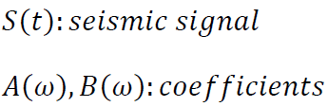
The need for Time freq analysis
Localized information is valuable
Fourier Transform: information of stationary signals
Seismic Signals: NON-STATIONARY
Stationary Signal: constant statistical parameters over time
Short Time Fourier Transform(STFT): Primary solution
Notes:
Wigner Rahaczek Page

Slide 5
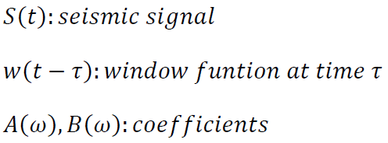
Short time Fourier Transform(STFT)
Break into segments
Applied FT on each segment
Lay out the spectrum along time
Display all the spectra
Assumption: truncated signals are stationary
Con: window determine combined resolution
Notes:
AssumptionThe truncated signal is considered stationary if the window is small enough.
Con: the resolution is fixed once the window is chosen.
The formula of Fourier transform with a window.
The multiplication in time domain is the convolution in spectral domain. Therefore, the spectrum is modified by the window. The major information is still preserved.
Resolution problem: Raisecos window figs

Slide 6

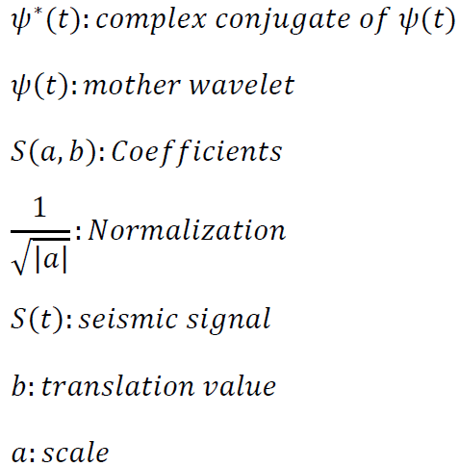
Wavelet Transform(WT)
Cross correlation
Display the coefficients
Continuous WT: sliding wavelet
Discrete WT: segments (correlate the segments with wavelet at the same time)
How much does the trace resemble the adjusted mother wavelet
Notes:
wavelet transform
(CWT) (DWT?)
CWT: sliding window
DWT: window segments (a sequence of windows at the same time)
In my view, wavelet transform is like a cross-correlation between the signal and the adjusted mother wavelet. What we get out of WT is a display of the coefficient of cross-correlation, in other words, the display shows how much alike is the signal compared to adjusted mother wavelet.

Slide 7
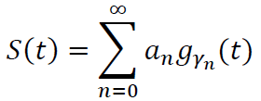
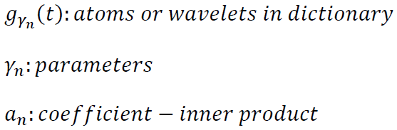
Matching Pursuit(MP)
Cross correlation
Subtract best matched wavelet
Iteration
FT on matched wavelet and project along time
Display
Matching Pursuit: a combination of WT & STFT
Easy reconstruction
Notes:
I would say a combination of CWT & STFT regression method
1 cross-correlation
2 Fourier transform
3 project along the window
Instead of using scale we use frequency as the direct parameter here
Easy to reconstruct the signal.
Iteration of CWT
Since the wavelet is axial symmetrical, cross-correlation is the same as convolution between the wavelet and the signal
Greed approach in statistical mean

Slide 8
Contents
Background---STFT, CWT and MPD
Fractional Matching Pursuit Decomposition
Computational Simulation
Results: MPD versus FMPD
Conclusion

Slide 9
Fractional MPD
Regression: stability problem
Subtract the matched wavelet with a portion of the coefficient
FMPD: much more laterally stable
Mitigate the interference effect
Notes:
I would say a combination of CWT & STFT regression method
1 cross-correlation
2 Fourier transform
3 project along the window
Instead of using scale we use frequency as the direct parameter here
Easy to reconstruct the signal.
Iteration of CWT
Since the wavelet is axial symmetrical, cross-correlation is the same as convolution between the wavelet and the signal
Greed approach in statistical mean

Slide 10
Contents
Background---STFT, CWT and MPD
Fractional Matching Pursuit Decomposition
Computational Simulation
Results: MPD versus FMPD
Conclusion

Slide 11
Algorithm
Input seismic trace
Wavelet Dictionary
Wavelet=Ricker(f)
correlation
Best Matched Wavelet
subtraction
energy>threshold
Residual Trace
summation
energy<threshold
Reconstructed trace
Residual
Notes:
Different phase = time shifted wave

Slide 12
Contents
Background---STFT, CWT and MPD
Fractional Matching Pursuit Decomposition
Computational Simulation
Results: MPD versus FMPD
Conclusion

Slide 13
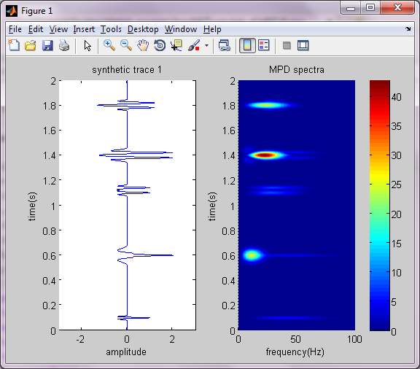
13

Slide 14

14

Slide 15
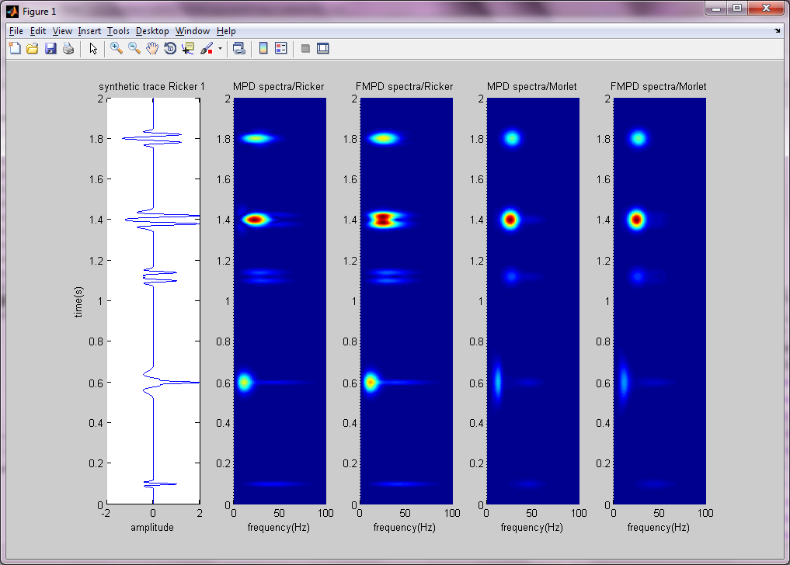

Slide 16
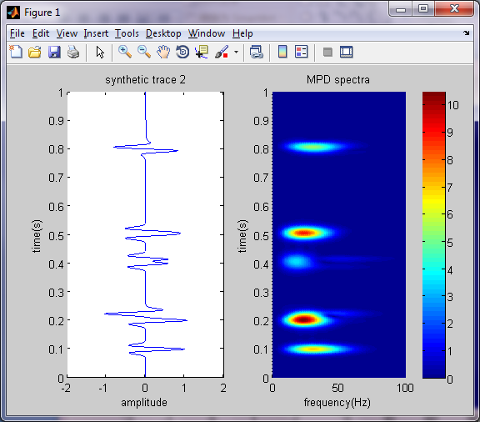
Ricker Criterion
Rayleigh Criterion

Slide 17
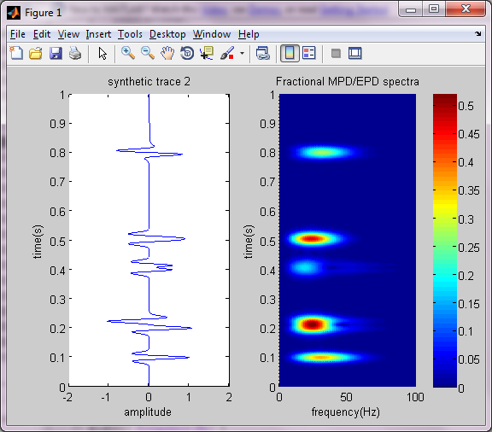
Ricker Criterion
Rayleigh Criterion

Slide 19
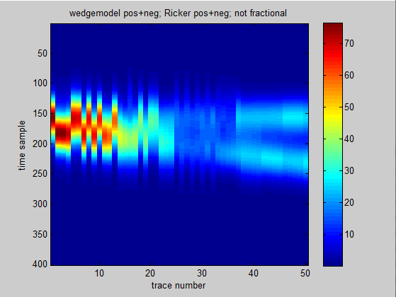

Slide 20
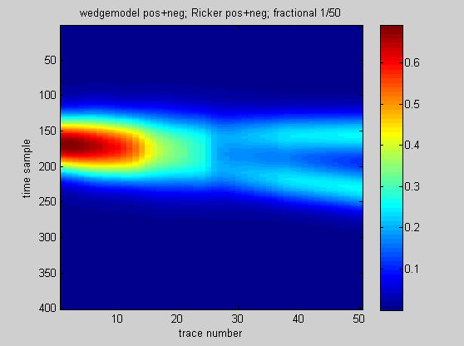

Slide 21
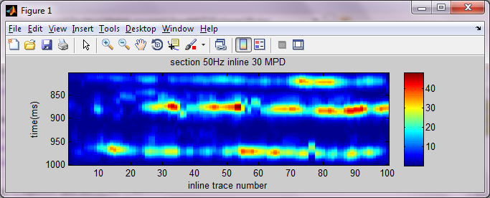
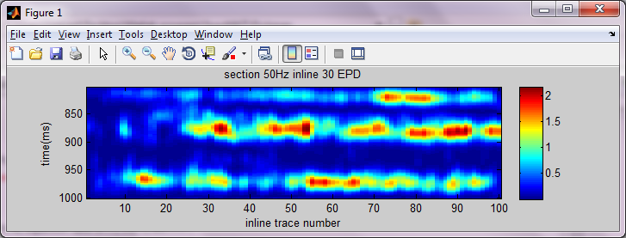
section 50Hz inline 30 MPD
section 50Hz inline 30 FMPD

Slide 22
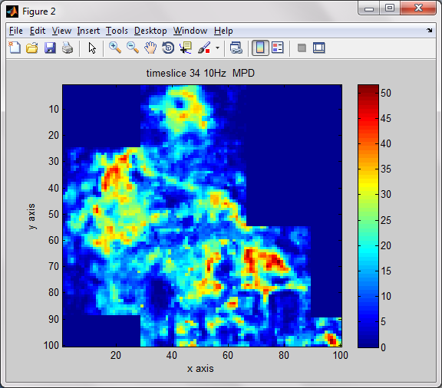
timeslice 34 50Hz MPD

Slide 23
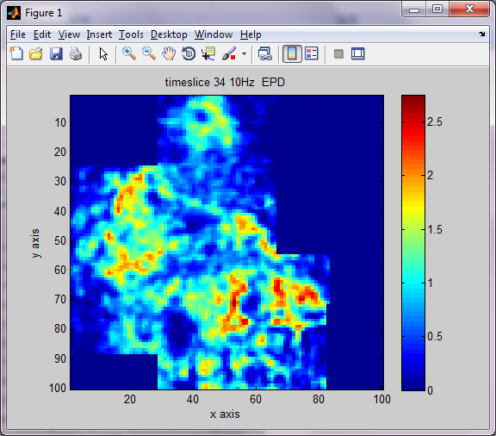
timeslice 34 50Hz FMPD

Slide 24
Contents
Background---STFT, CWT and MPD
Fractional Matching Pursuit Decomposition
Computational Simulation
Results: MPD versus FMPD
Conclusion

Slide 25
Conclusion
Matching Pursuit Decomposition is laterally unstable
Fractional Matching Pursuit Decomposition solves the problem
Notes:
More complicate MPD instead of greedy approach could be explored deeper.

Slide 26
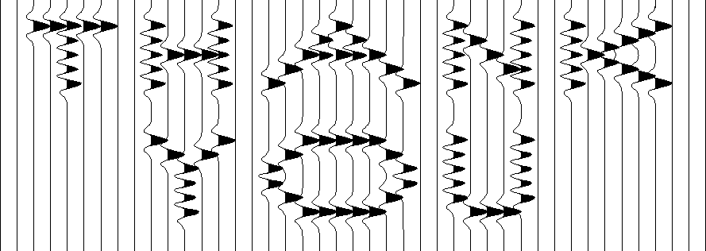
60Hz Ricker
Questions? Comments?
Notes:
When we look at the seismic trace, we hope to see bright spot say thank you for getting me out of jail

Slide 27
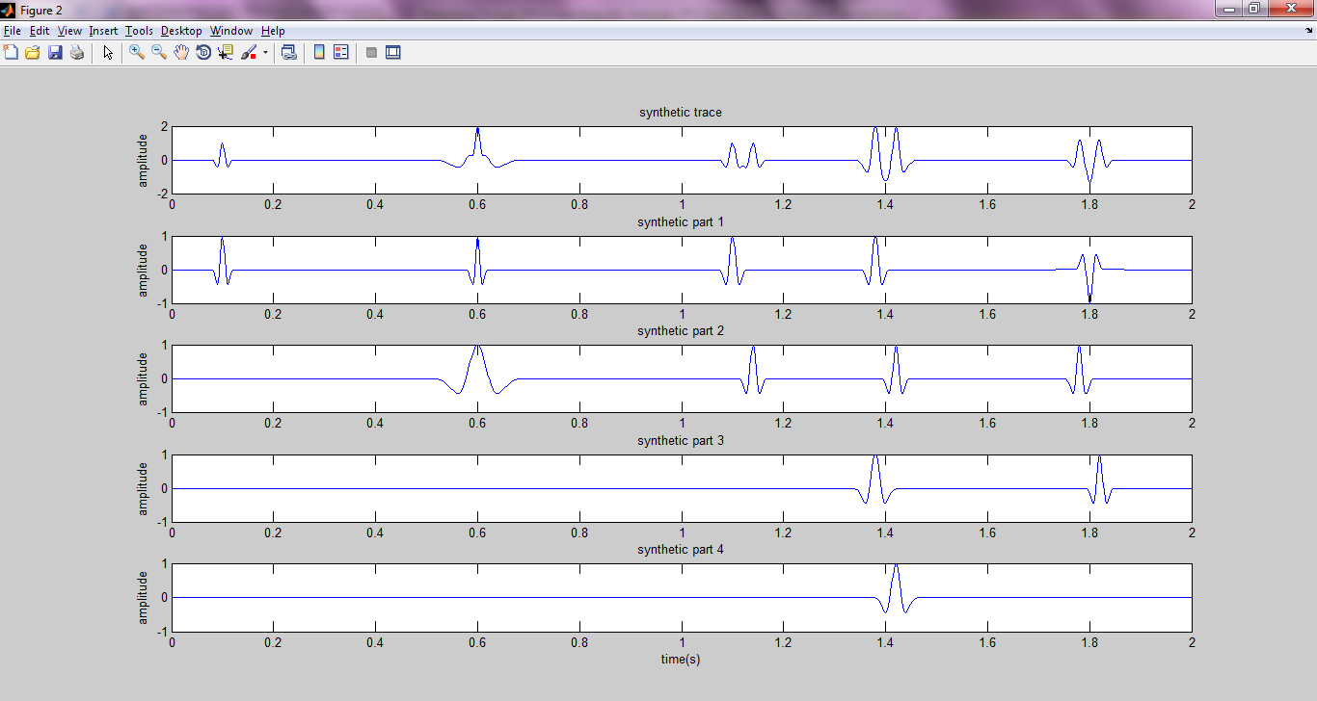

Slide 28
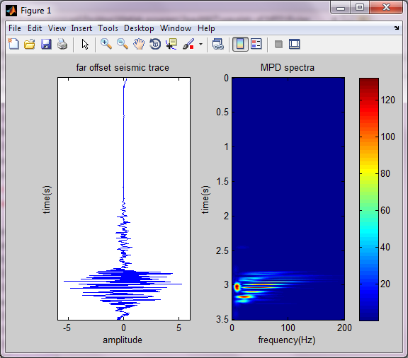

Slide 29
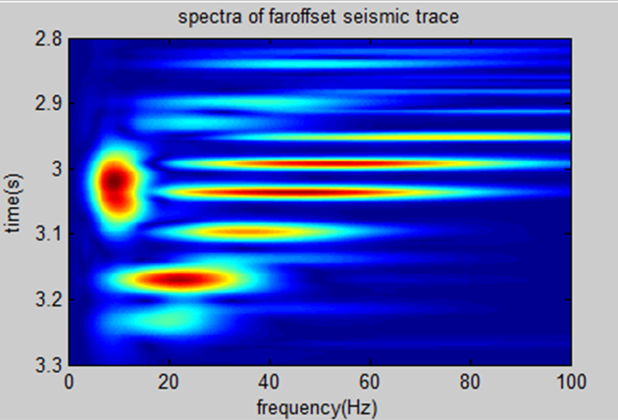

Slide 30
30

Slide 31
31

Slide 32
Motivation
Alternative time frequency analysis method
New representation provides new perspective new attributes
Convolution model base
Extracted wavelet---Ricker like
Application: Gas Brine differentiation; channel detection
Simple representation---more to discover
Notes:
Motivation
An alternative
Gas Brine differentiation
Instead of knowing what frequency occurred at what time. We want to know when did those event occur, those reflection
We tend to simplify complicated seismic trace to convolution model, so what we mostly care is those major events
A new way of representation makes new attributes possible
Instantaneous frequency?

Slide 35
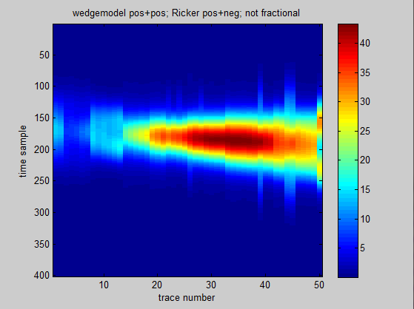

Slide 36
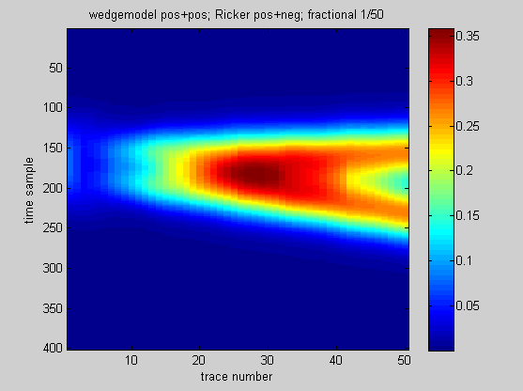

Slide 37
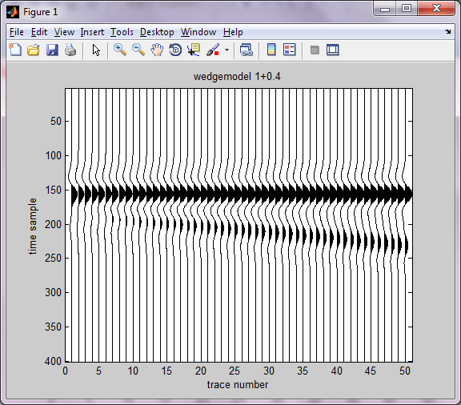

Slide 38
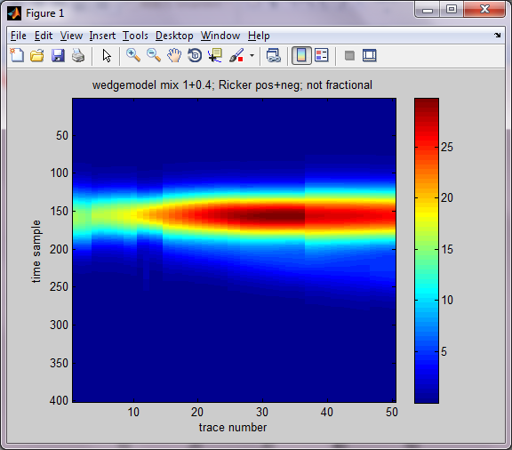

Slide 39
